Slide 1
WT presentation
Sever-Side technology

Slide 2


Introduction to Server-Side Technologies
A client is a piece of software which operates on the local system and makes HTTP requests to a server.
Client-side technologies can be faster and safer than server-side technologies; however they are limited in functionality and cannot interact with permanent storage such as a database.
If web-application requires permanent storage, for example you want users to add to data or pull information that is stored, server-side technologies are required to complete these processes.

Slide 3
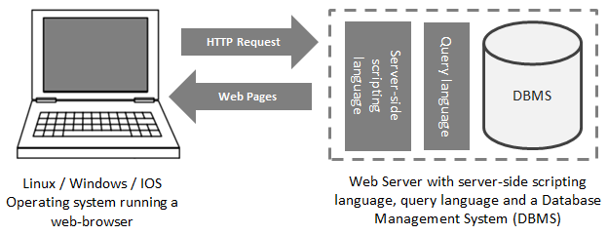
How it works

Slide 4






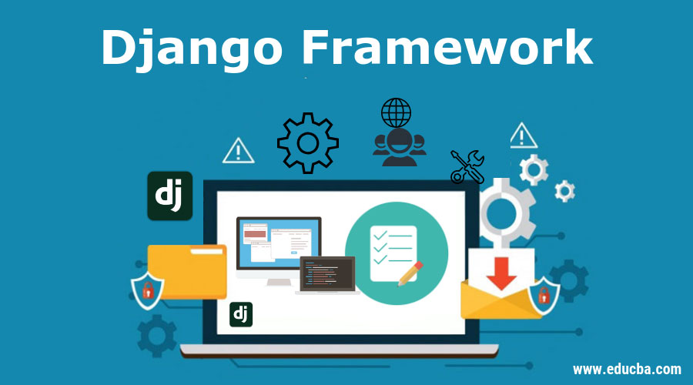

Django
Django is high-level Python web framework that encourages rapid development and clean, pragmatic design.
Ridiculously Fast
Reassuringly Secure
Exceedingly Scalable

Slide 5
How does Django works
www.youtube.com
Request
MODELS.PY
Query Sets
VIEWS.PY
Result set
Response
Read/ Write
Templates
Index.html
(HTML – JS – CSS)
DATABASE

Slide 6
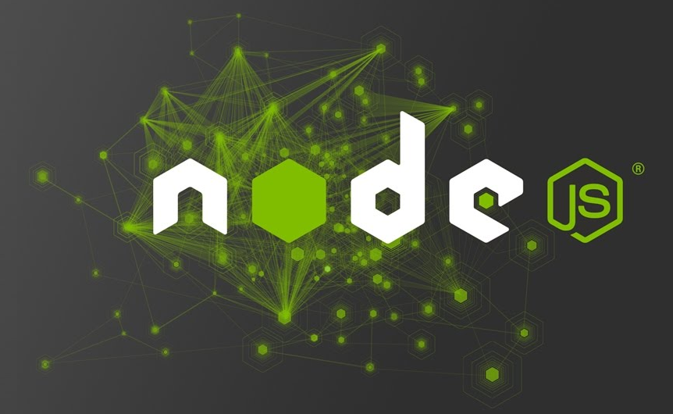
What is node js ?
Node.js is an open-source, cross-platform, back-end JavaScript runtime environment that runs on the V8 engine and executes JavaScript code outside a web browser.
Using HTTP module we can use node js as server side component.
Express.js, Meteor.js, Nest.js, Hapi.js are popular node.js frameworks

Slide 7

Why is node js so famous?
We can built the entire web application from start to end using one language JavaScript.
MEAN: MongoDB Express Angular Nodejs
MERN: MongoDB React Angular Nodejs

Slide 8


Express
Express is a very popular web application framework built to create Node.js Web based applications.
It provides an integrated environment to facilitate rapid development of Node based Web applications.
Express framework is based on Connect middleware engine and used Jade html template framework for HTML templating

